Slide 1
Migrate and modernize your data estate
Section 1: Introduction
Section 2: SQL Server migrations
Section 3: Open-Source database migrations
Section 4: Expanding the data estate
Section 5: Getting started
August 2022

Slide 2

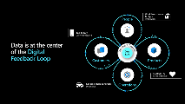
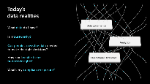
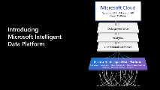
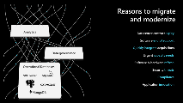
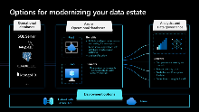
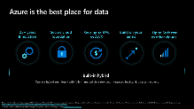
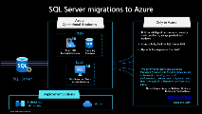
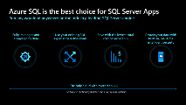
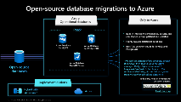
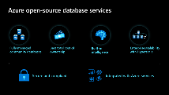
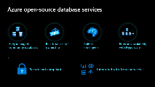
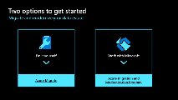
Migrate and Modernize your data estate
Data & Digital Transformation = MIDP
Azure options. Why Azure for M&M
Intro
Data as a strategic asset
Data is at the center of the Digital Feedback Loop
SQL Server migrations
Azure options. Why SQL in Azure
Open-source database migrations
Azure options. Why OSS in Azure
Expanding the data estate with analytics
Azure options. Why analytics, AI and Data Governance in Azure
Getting started
Self-serve + MS supported

Slide 3

Migrate and modernize your data estate

Slide 4
















Data as a strategic asset
Work from home 12-3pm
Hybrid work
1,500 STEPS
Intelligent center
Tap to buy
Customer focused
Call ride-share reminder
Super apps

Slide 5




Data is at the center of the Digital Feedback Loop
Work from home 12-3pm
Hybrid work
People
Signal
Action
Tap to buy
Customer focused
Action
Signal
Intelligent Systems
Data & AI
Customers
Products
Signal
Action
1,500 STEPS
Intelligent center
Action
Signal
Call ride-share reminder
Super apps
Operations

Slide 6
Today’s data realities
3
What data do I have?
Data governance
Is it trustworthy?
2
Analytics & AI
Can people access the data needed to make the right decisions?
1
How can I enable faster business insights?
Operational Databases
Operational databases
What’s my compliance exposure?

Slide 7
Introducing Microsoft Intelligent Data Platform
2
Microsoft Cloud
Dynamics 365 • Microsoft 365 Power Platform
3
2
Data governance
Analytics & AI
1
Operational Databases
2
Microsoft Intelligent Data Platform
SQL Server • Azure SQL • Azure Cosmos DB • Azure Synapse Analytics
Power BI • Microsoft Purview • Azure Machine Learning

Slide 8
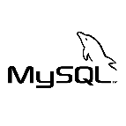






Reasons to migrate and modernize
2
Analytics & AI
Datacenter contract expiry
Software end of support
Quickly integrate acquisitions
Urgent capacity needs
Software & hardware refresh
Security threats and Compliance
Application innovation
3
Data governance
1
1
Operational Databases
Operational Databases
Operational databases
SQL Server
Operational databases
…
SQL Server

Slide 9




Options for modernizing your data estate
1
2
Operational databases
Azure
Operational databases
Analytics, AI and Data governance
SQL Server
PaaS
Benefits
Built-in intelligent performance and scaling for faster apps
More secure applications with database monitoring and patching
+ IaaS benefits below
Benefits
IaaS
Benefits
Comprehensive data security and controls
Ability to reason over any data with Predictive and Prescriptive Analytics
Faster time to insights for All
More resilient systems with High Availability, Disaster Recovery, Back-ups
…
Deployment options
Hybrid with Azure Arc¹
Azure
1. Other hybrid options available

Slide 10
Do more with less with Azure databases
25+ years Innovation
Secure cloud foundation
Save up to 93% vs AWS ¹
Cloud on your terms
Up to 5x faster vs other clouds ¹
Built-in hybrid
Operate hybrid seamlessly with fully-managed data services, integrated backup & disaster recovery
1. Microsoft Azure SQL Managed Instance (principledtechnologies.com).

Slide 11

SQL Server migrations

Slide 12
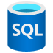
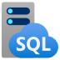
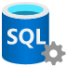


SQL Server migrations to Azure
1
1
Azure
Operational databases
Only in Azure
PaaS
Built-in intelligent performance, security and compliance, always patched and updated
Compatibility back to SQL Server 2008
Up to 93% less expensive than AWS
Azure SQL Managed Instance
Azure SQL Database
IaaS
“We determined Azure SQL Database Managed Instance was the best choice for us in terms of scalability, cost, and performance.… We’ve seen a 49 percent cost reduction and 25 to 30 percent performance gains.”
SQL Server
SQL Server on Azure Virtual Machines
Nipun Sharma, Analytics Architect, Business Technology and Systems
Deployment options
Hybrid with Azure Arc ¹
Azure
Read the story
1. Other hybrid options available

Slide 13
Azure SQL is the best choice for SQL Server Apps
Run any workload anywhere on the industry-leading SQL Server engine
Fully-managed and always up to date
Use your existing SQL experience in the cloud
Save with the lowest total cost of ownership
built-in, real-time intelligent security
The only cloud with evergreen SQL
Software is continually updated and never requires patches

Slide 14

Expanding the data estate

Slide 15





Leverage the best of the Microsoft Intelligent Data Platform
1
1
1
Operational databases
Analytics & AI
Data Governance
Business Intelligence
w/ Power BI
PaaS
Microsoft Purview
Business
Data Marts
Self-Serve
Reporting, Data Visualization, and AI
Organizational and B2B Collaboration
Data Estate Map
Lineage Tracing
Metadata Management
Security and Access Management
Compliance
Data Quality Management
Data Catalog
Machine Learning and AI with Azure AI
IaaS
OpenAI Models
MLOps
Intelligent
Apps
Hybrid
Analytics
Foundation w/ Synapse
Always Synchronized
1-Copy Integrations
Open Standards
Data Lakehouse
Spark and SQL
Compute
1
Only in Azure
“Synapse Link for SQL Server 2022 helps us to seamlessly replicate operational data in near real time to be able to have more powerful analytics.”
Seamless integration across Azure databases
Insights up to 380 percent faster ¹
49 percent less expensive than other cloud providers ¹
Javier Villegas, IT Director for DBA and BI Services
1. Cloud Analytics Platform Total Cost of Ownership, GigaOm

Slide 16
Expanding the data estate with analytics
Derive value from your data with Azure Synapse Analytics and Power BI
Faster time to insights
Access for all
Comprehensive security and control
Near real-time
insights
Best price performance in the market
Source: Cloud Analytics Platform Total Cost of Ownership, GigaOm

Slide 17
Two options to get started
Migrate and modernize your data estate
Do it yourself
Work with Microsoft
Azure Migrate
Azure Migration and Modernization Program

Slide 18
Thank you.

Slide 19
Additional Resources
Migration resources
Azure migration center
Azure Database Migration Guide
Find a partner
Azure Database Migration Service (DMS)
Azure DMS documentation
Demos
Migrating and modernizing your data estate to Azure with Data Migration Services
Database migration roadmap with Microsoft
Blog
Data Migration Team Blog
Web pages
Azure SQL family webpage
3rd party studies
Azure SQL Managed Instance vs AWS RDS
SQL Server on Azure Virtual Machines vs AWS EC2
Resources - infographics
Azure SQL family
Forrester Consulting Total Economic Impact™ study
Azure SQL Database serverless
Web App Migration Datasheet

Slide 20
Azure SQL
The family of SQL cloud to edge databases
SQL Server on Azure Virtual Machines
Azure SQL Managed Instance
Azure SQL Database
Azure SQL Edge
Best for lift and shift and/or workloads requiring OS-level access
Best for modernizing existing apps
Best for supporting modern cloud apps
Best for extending apps to IoT edge
Infrastructure-as-a-Service
Platform-as-a-Service
Edge Computing
Azure SQL enabled by Azure Arc
Run Azure SQL on premises and in multi-cloud environments
Azure is the cloud that knows SQL Server best

Slide 21
Key offers lower your total cost of ownership
Azure Hybrid Benefit
Maximize existing investments in on-premises licenses with discounted rates on Azure SQL Database. Save up to 59% vs. AWS.
Reserved capacity
Reserve Azure SQL resources in advance and save up to 33%. Combine with Azure Hybrid Benefit for savings up to 80%.
Dev/test pricing
Save up to 55% versus list prices, eligible with active Visual Studio subscriptions .
Extended security updates
Get free extended security updates for SQL Server 2008, 2008 R2 and 2012 for three years when running on Azure Virtual Machines.

Slide 22
Modernize to Azure SQL databases
Key report benefits and findings¹
Up to 47%
Cost savings on Azure SQL VMs vs on-premises SQL Server
Innovate faster and accelerate time to market
Modernizing on Azure SQL yields even greater benefits…
Always operate on the latest version of SQL
53%
Lower cost of application administration
+17%
Additional cost savings on Azure SQL managed databases vs Azure SQL VMs
Increase operational efficiency and savings
Eliminate software expenses
+$30M
Additional revenue due to faster time to market
90%
Lower cost of systems administration
Improve business agility
¹ Results are based on interviewed customers. “The Economic Value of Migration On-premises SQL Server Instances to Microsoft Azure SQL Solutions,” a commissioned study conducted by The Enterprise Strategy Group on behalf of Microsoft, October 2020.

Slide 23
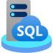

Azure hybrid destination for SQL Server
Azure Arc-enabled SQL Managed Instance
SQL Server on
Arc-enabled servers
Azure SQL Managed Instance
on any infrastructure
Fully automated, evergreen SQL Server
Cloud billing model for on-premises
Organize, inventory
Azure Defender for advanced security
Free SQL Assessment service

Slide 24







Azure Arc-enabled data services
Bring cloud data management to any infrastructure
Supports all connectivity modes
Always up to date
Multi-layer security
Elastic scale
Simplified DevOps
Automated updates
No downtime, evergreen
Comprehensive encryption
Azure RBAC & Policy
Scale up and down
Pay for what you use
Deploy in seconds
Built in HA/DR
Any infrastructure

Slide 25





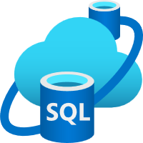

SQL Server 2022 Azure-enabled with continued performance and security innovation
Business continuity through Azure
Seamless analytics over on-prem operational data
Visibility over your entire data estate
Most secure over the last 10 years¹
Industry-leading performance and availability
Microsoft Purview
+
Data Insights
Data Catalog
#1 OLTP performance²
#1 Non-Clustered DW performance on 1TB³, 3TB⁴, 10TB⁵, 30TB⁶, and 100TB⁷
Data Map
Hero capabilities
Bidirectional DR to Azure SQL⁸
Azure Synapse Link
Microsoft Purview integration
SQL Server ledger
Built-in query intelligence
Multi-write replication
Most consistent data platform
Edge to Cloud
Azure SQL Edge
Azure Arc-enabled data services
Azure SQL
All TPC Claims as of 04/06/2022.
¹National Institute of Standards and Technology Comprehensive Vulnerability Database ² http://www.tpc.org/4087; ³ http://www.tpc.org/3374; ⁴ http://www.tpc.org/3380; ⁵ https://tpc.org/3383; ⁶ http://www.tpc.org/3364; ⁷ https://tpc.org/3382;
⁸Bidirectional disaster recovery capability of link feature for Azure SQL Managed Instance public preview will occur at a future date.

Slide 26









More reasons to pick Azure for SQL Server workloads
SQL Server on Azure Virtual Machines
Azure SQL Database & Azure SQL Managed Instance
Free support for SQL Server 2008/R2
Get free extended security updates for SQL Server 2008/R2 images in Azure IaaS for three years
Best total cost of ownership
Save up to 88% on Azure SQL Database compared to AWS RDS. Free built-in HA and Zone Redundancy
Free DR in Azure and unlimited virtualization
On-premises SQL Server with Software Assurance now comes with free SQL license for Azure DR secondary, and full control over virtualization when entire host is licenses with SQL Server EE and Windows Server Datacenter
Evergreen SQL
Stay always up to date with Azure SQL Database, with full parity based on 100% code consistency
Industry’s highest SLA on Azure SQL Database
Experience up to a 99.995% availability SLA and the industry’s first 100% business continuity SLA
Automatic updates
Ease of maintenance with automatic application of the latest security patches, only on Azure
Pre-configured cloud backup
Restore to a specific point in time with an automatically-generated Azure backup
Intelligent performance and security
Optimize performance and security with built-in, ML-based features that act on your behalf
Only cloud with Developer edition
Access the fully-featured free SQL Server Developer edition, only pre-configured on Azure
Faster cloud innovation
Integrate with Azure App Service and Power Apps for fast app innovation. Built-in R and Python support with Machine Learning Services.
Unmatched security
Proactively safeguard your data with Advanced Data Security. Streamline compliance with 90+ compliance offerings, the most comprehensive of any cloud service provider. Available in 60+ regions to meet local data residency requirements.

Slide 27
Which Azure SQL offering is right for you?
App Innovation
Benefits of PaaS
Lower administrative burden
No End of Support hassles
Fully managed and always up to date
Dynamic resource scaling
Built-in high availability and automatic backups
Multimodel capabilities
Do you need
Yes
A database model?
Resource pooling for multi-tenant SaaS?
Up to 100TB of database storage?
To automatically pause/restart a workload?
Azure SQL Database
No
App Modernization
No
Do you need
*
An instance model?
On-premises SQL Server compatibility?
Native vNet support?
Near real-time data replication from on-premises to the cloud?
Yes
Azure SQL Managed Instance
Migration
No
Benefits of IaaS
Maintain OS-level control
Easy lift-and-shift eliminates app refactoring
Faster path to the cloud
Do you need
*
OS level access?
Capabilities at the VM level?
SQL Server versions 2008 - 2022?
SSRS/SSAS?
Yes
SQL Server on Azure VMs
* Use Azure Arc to enable the same services in your datacenter or on the cloud of your choice, when a hybrid or multicloud approach is required

Slide 28


Your business intelligence tools in Azure
Move to Azure VMs or choose managed services for data integration and analysis
SSIS
Azure Data Factory (ADF) SSIS
Your solution for building data integration and transformation solutions
SSRS
Power BI (PBI)
Your platform for creating, deploying, and managing mobile paginated reports
SSAS
Azure Analysis Services (AAS)
Your service for creating and analyzing multidimensional data models

Slide 29
Increase control on VMs with Azure Dedicated Host
Azure Dedicated Host enables customers to run Linux and Windows virtual machines on single-tenant servers
Control Determine maintenance cycles, VM placement and underlying server capabilities
Compliance Alignment with corporate policies and licensing agreements requiring host level isolation or a dedicated physical server
Cost savings Take advantage of Windows and SQL Server Software Assurance benefits, Azure Hybrid Benefit, and extended security updates
Unlimited virtualization rights Customers with Software Assurance have full control over virtualization when entire host is licensed with SQL Server Enterprise Edition and Windows Server Datacenter

Slide 30
SQL IaaS Agent Extension simplifies security, high availability, and storage
Optimize
cost
Enhance security
Boost
uptime
Simplify management
See all your SQL Server on Azure VMs in one location, convert between license types, and save by paying only for what you use
Manage security patching and easily implement encryption features for better security and compliance
Automate backup, easily configure high availability, and take advantage of HA/DR license benefits to enhance business continuity
Automatically implement storage best practices and configure your storage settings more optimally for SQL Server
IaaS++
Learn more aka.ms/sqlvm_rp_documentation

Slide 31
Azure takes the admin out of MySQL and PostgreSQL
Intelligent security
Azure Databases for PostgreSQL, MySQL and MariaDB are fully managed, enterprise-ready community databases-as-a-service.
Intelligent performance
Applications
Applications
Applications
Data
Data
Data
Greater manageability and security
Improved performance and intelligence
Global scalability
Built-in tools and resources
High availability /DR/Backups
High availability /DR/Backups
High availability/ DR/Backups
Database provision/ Patch/Scaling
Database provision/ Patch/Scaling
Database provision/ Patch/Scaling
O/S provision /patching
O/S
O/S
Virtualization
Virtualization
Virtualization
Hardware
Hardware
Hardware
Machine learning capability
Datacenter management
Datacenter management
Datacenter management
Managed by customer
Managed by Microsoft
On-premises
PostgreSQL, MySQL and MariaDB
IaaS
Azure VMs with PostgreSQL, MySQL, and MariaDB
PaaS
Azure Database for PostgreSQL, MySQL, and MariaDB

Slide 32
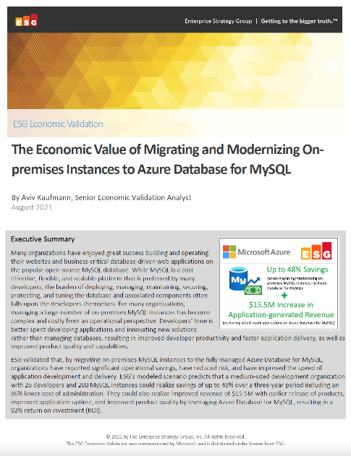
Significantly reduce cost when migrating workloads to PaaS
Key report benefits and findings¹
Up to 48%
Cost savings when migrating on-premises MySQL instances to Azure Database for MySQL
Microsoft commissioned Enterprise Strategy Group to conduct an Economic Value study to examine potential cost savings and business benefits enterprises would achieve from migrating on-premises workloads to Azure Database for MySQL.
Modernizing on Azure Database for MySQL yields even greater benefits…
93%
Reduction in
operational cost
+$15.5M
Additional revenue due
to faster time to market
86%
Lower cost of systems administration
92%
ROI expected over
the first year
¹ Results are based on interviewed customers. “The Economic Value of Migrating and Modernizing On-premises Instances to Azure Database for MySQL,” a commissioned study conducted by The Enterprise Strategy Group on behalf of Microsoft, September 2021.

Slide 33






Azure is the home for your Oracle workloads
Leverage Azure with IaaS options or migrate to a fully managed database for more benefits
Oracle on Azure IaaS
Modernize to fully managed databases
Get more with fully managed databases
Azure Virtual Machines (IaaS)
Azure Database for PostgreSQL
Azure SQL
Azure
Cosmos DB
Maximum control
Fully managed
Always on Azure
Intelligent Performance
Proven resilience & stability
Enterprise ready
Lower TCO
Built-in security
Integrated with Azure data ecosystem
Highly scalable
High Availability

Slide 34

Oracle to Azure
Migrate or modernize your Oracle workloads to Azure for greater flexibility, scale, and innovation, with industry leading security and compliance. With Azure VMs to cloud-native relational and non-relational databases, Azure has a home for all your Oracle workloads.
Greater control and flexibility in the cloud
Scalable infrastructure and guaranteed high availability
Operational and business agility to drive innovation
Advanced data security and compliance
From IaaS to cloud native databases, Azure has a home for your Oracle workloads.
Choose from a variety of databases to fit your needs, including fully managed relational and non-relational databases.
Achieve massive scale for your mission critical applications with SLA-backed high availability guarantees.
Azure offers global coverage and enterprise-ready performance to empower your business.
Gain immediate agility and efficiencies with Azure to run and modernize your Oracle workloads.
Free up resources to enable new insights and application innovation.
Protect your apps and data with multi-layer, enterprise-grade cloud security and compliance.
Built-in security controls help to identify and protect against threats.

Slide 35
Migrate your Oracle workloads to Azure
Rehost: Oracle to Azure IaaS
3P ISV App Supported only on Oracle
3P ISV App with PostgreSQL/SQL Support
1P Oracle Application
Custom Apps and Data Warehouses
Refactor to
Azure Database for PostgreSQL
Azure SQL
Or
Right-size then Lift and Shift
Oracle on Azure IaaS
Rearchitect and Migrate to
Azure Database for PostgreSQL
Azure SQL
Azure Cosmos DB
Azure Synapse
Or
Right-size and Lift and Shift
Oracle on Azure IaaS
Right-size then Lift and Shift
Oracle on Azure IaaS
Right-size then Lift and Shift
Oracle on Azure IaaS
Examples include:
E-Business Suite, Peoplesoft, Hyperion Essbase, Opera, Oracle Exadata workloads and more)
Refactor
Rearchitect
Rehost

Slide 36


Datamart in Power BI Democratize data for every level of your organization
Ingest & Prep
An intuitive low code experience to create a datamart in Power BI with full web authoring
Unified semantic models
An autogenerated self-tuning dataset and an interface that enables defining BI measures, relationships and security rules kept in sync with the database
Integrated governance
Microsoft Purview Information Protection, sensitivity labels, lineage, endorsement, deployment pipelines and end to end monitoring built in
Ease of use
Includes full sharing, ready to build Power BI reports and is discoverable where users work – Data Hub, Excel, Teams
Data sources
…

Slide 37
The benefits of a self-service datamart Provide business users a simple, frictionless experience to ingest data from different data sources transform the data and deliver faster insights to increase productivity.
Faster Time to Insights
Free up time for your IT department, with a self service datamart.
Access for All
Unlock new insights by enabling everyone to ingest, transform, integrate, enrich, and explore their own mix of data. By using datamart in Power BI, every role in your business can drive clarity while reducing the load on IT.​
​
Comprehensive Security and Control
With peace of mind, have total control over governance, manageability, and end-to-end data lineage.​
Datamart in Power BI allows business users to build end-to-end BI solutions by starting with the creation of a customized datamart that leverages existing Power BI capabilities for loading and modelling.

Slide 38

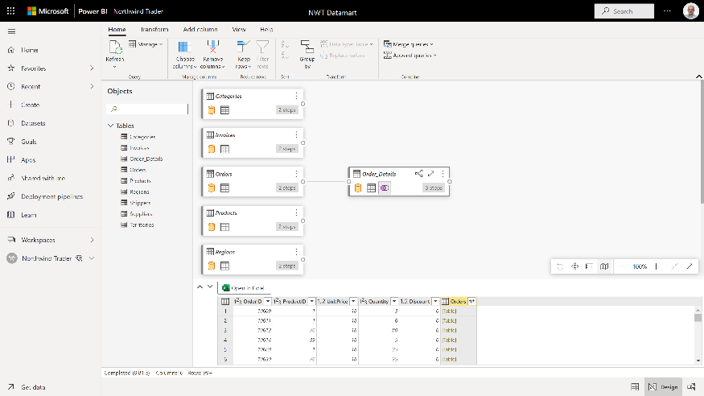
Simplify data ingestion, transformation, integration and enrichment for all Accelerate creation of modern datamarts​
The solution to small data Securely uncover insights from workloads up to 200GB*
No tuning or optimization required Ingest data from different data sources, ETL the data through Power Query and load the data into a SQL Database.
Familiarity enriched
Build a datamart on the same SaaS experience you know with Power BI.
*datamart size recommendation during public preview

Slide 39
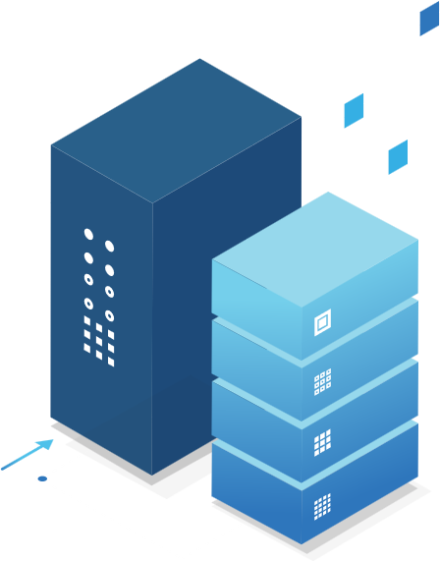








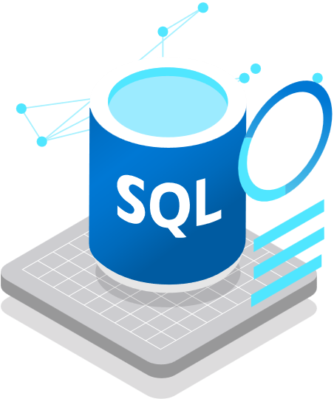


Azure Synapse Link
for SQL
Operational Databases
SQL Server 2022
Azure Synapse Link for SQL
Azure Synapse Link
for Dataverse
Azure SQL Database
Operational Databases
Business Apps
Azure Synapse Link for SQL provides near real-time insights and hybrid transactional/analytical processing (HTAP) with minimal impact on operational workloads.
Azure Synapse Analytics
Azure Synapse Link
for Cosmos DB
Operational Databases

Slide 40









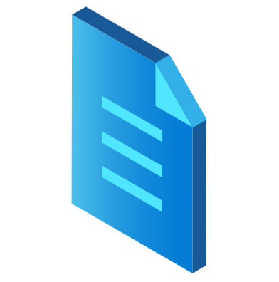












Azure Synapse Link for SQL
Simplified experience
Centralized data
Near real-time insights
Minimized overhead
With a streamlined setup, transfer data from operational systems seamlessly
Consolidate data from multiple sources into a single analytics solution
Maximize impact with automated systems, capturing and updating data in near real-time
Record data changes without stretching source systems

Slide 41
Azure Synapse Link for SQL
Automate data transfer and eliminate barriers with Azure Synapse Link for SQL
Operational Databases
Reduce latency and gain near-real-time insights with seamless data pipelines.
Simplify the multi-step process of extracting, transforming, and loading (ETL) data.
Apply Azure Synapse Analytics to various data sources whatever their size, scale, and format.
Gather impactful insights through hybrid transactional and analytical processing with minimal impact on operational systems.
SQL Server 2022
Azure Synapse Link for SQL
Azure SQL Database
Operational Databases
Azure Synapse Analytics

Slide 42
Take advantage of offers to lower migration costs
Microsoft Cloud Adoption Framework
Azure Migration and Modernization Program
FastTrack for Azure
Azure Migrate
Proven guidance to accelerate your cloud adoption journey
Best practices & resources, including Azure engineering & specialized partners
Single hub for all your migration needs

Slide 43

Introducing the Holistic Business Case Assessment
Migrate with confidence
Holistic Business Case
Leveraging Unifycloud technology, this assessment offers an extensive analysis of the customer’s infrastructure, databases and applications to provide a business case for migration
Ideal for customers concerned about…
✓
Difficulty aligning cloud strategy to business needs
Planning a migration to Azure PaaS services as priority from their existing on-prem Applications (SQL Server or Open Source database based) running on Windows or Linux
✓
✓
Guidance to understand the financial complexities surrounding a comprehensive cloud migration
Want more information?
Learn more with the Azure Foundation Assessment materials.

Slide 44
Assess your IT environment Azure Migrate
Multiple scenarios
Migrate Windows and Linux Servers, Databases, Data, Web Applications and Virtual Desktops
Diverse capabilities
Comprehensive discovery, assessment, and migration capabilities powered by Azure and third-party tools
Azure Migrate
Centralized visibility
Centralized migration repository delivering end-to-end tracking and insights

Slide 45
Azure Migration and Modernization Program (AMMP)
Get support with your migration and modernization needs across Data, Infrastructure and Apps
Proven approach: Microsoft Cloud Adoption Framework and Well Architected Framework
Cost-effective offers and incentives
Technical skill building
Free tools/ automation: Azure Migrate
In-depth assistance from FastTrack for Azure engineers
Expert help from specialized services partners
Support environmentally sustainable initiatives
Migrate and modernize your data workloads
Migrate SQL Server and OSS databases to Azure
Modernize apps + supporting database backends (incl. SQL Server, MySQL, Postgres, NoSQL)
Microsoft investment in your project → partner funding + Azure credits + technical skilling
Learn More | Azure.com/AMMP
Work with your partner or Microsoft account team to get started

Slide 46





Migration tools for your cloud journey
On-premises
Other clouds
Microsoft Azure
Assessment
Migration
Azure Migrate, SQL Server Migration Assistant, Data Migration Assistant, Database Experimentation Assistant
Azure Database Migration Service, Azure SQL Migration extension in Azure Data Studio

Slide 47


The Allscripts prescription for agility: lift and shift to the cloud
Allscripts is a leading healthcare software manufacturer, serving physician practices, hospitals, health plans, and Big Pharma. To transform its applications frequently and host them securely and reliably, Allscripts has started to use Microsoft Azure. In just three weeks, the company lifted and shifted dozens of acquired applications running on 1,000 virtual machines to Azure. Allscripts also develops software in Azure and realizes dramatic time-to-market gains and savings by using the Azure platform as a service offering.
Products and services
Microsoft Azure
Azure Cosmos DB
Azure Site Recovery
Azure SQL Database
Azure Virtual Machines
Organization size
10,000 employees
Industry
Partner professional services
Country
United States

Slide 48


Komatsu achieves breakthrough performance gains and savings with Azure SQL Managed Instance
Komatsu builds and sells a lot of heavy equipment, but the company knows that it takes more than machines to be successful. Using data to gain a better understanding of its own business—and to help customers better understand theirs—is key to developing innovative services and leading its industry. By moving mainframe applications to Microsoft Azure SQL Managed Instance, Komatsu Australia is improving performance, reducing costs by half, and providing employees and customers with the data they need when they need it.
Products and services
Microsoft Azure
Azure Analysis Services
Azure ExpressRoute
Azure SQL Managed Instance
Microsoft Power BI
Organization size
3,200 employees
Industry
Manufacturing
Country
Australia
Partner
TimeXtender

Slide 49


H&R Block delivers scalable, multichannel tax preparation services with Azure SQL Managed Instance and SQL Server on Azure VM
H&R Block wanted to unify its disparate data sources so the company could deliver more seamless multichannel experiences and provide better service for its customers. By moving various workloads to Microsoft SQL Server 2017 and Microsoft Azure and using Azure data services, the tax provider has been able to enhance service delivery, scale to meet its peaks in demand, and accelerate innovation. Starting with SQL Server on Azure Virtual Machines and later adding Azure SQL Managed Instance, H&R Block improved application performance and reduced roadblocks to innovation. Now it can meet the future head on—and deliver smart, powerful multichannel experiences that keep customers coming back.
Products and services
Azure
Azure Databricks
Azure SQL Database Managed Instance
Organization size
Corporate (10,000+ employees)
Industry
Professional Services
Country
United States
SQL Server on Azure Virtual Machines
SQL Server 2017
Azure DevOps

Slide 50


ÖBB expands its business and improves time to market using Azure
Challenge
OBB set the goal of creating a ticket-selling platform that could be used for all public transportation in Austria. This led the team to consider transforming their Ticketshop platform to enable growth at scale. To operate Ticketshop at this scale suggested cloud computing.
Solution
Azure Database for PostgreSQL enabled:
High availability with automatic failover on Flexible Server
Lowered operational overhead as a fully managed service
Live migration through the partner Striim
New opportunities for innovation with AKS
Simplified migration from language similarity with PL/pgSQL

Slide 51


HarvestMark chooses Azure over Amazon for improved security and performance
Customers of HarvestMark wanted them to find a new cloud-services provider that would avoid a conflict of interest and give them the performance and peace of mind for their solutions
HarvestMark migrated its existing PostgreSQL database to Microsoft Azure Database for PostgreSQL​ in just two hours
During the migration there was no impact to their customers.
HarvestMark saw a 20 percent decrease in cloud hosting service costs.
The company maintains its high standards for reliability and speed with Azure.

Slide 52


GeekWire is serves 2 million readers worldwide with Azure Database for MySQL
Challenge
Solution
Outcome
Traffic increases led to performance concerns
Migrate from WordPress site to Azure Database for MySQL
On-demand scaling and 45% reduction in costs
“Our page load times are very low, and we're able to do it on a more powerful and scalable infrastructure that costs us 45 percent less.”
Kevin Lisota Web Developer

Slide 53


Symantec migrates Cassandra data and discovers 40% savings and more reliability
Challenge
Symantec was managing their storage and Cassandra databases within their own datacenters, which was both costly and time-consuming to prevision resources.
Solution
Azure Cosmos DB delivered:
Seamless migration with Azure Cosmos DB Cassandra API
40% database management savings with elastic and automatic scaling
Ease of mind with 99.999% availability worldwide
“Now we can focus on our core competency, and we can go back to writing security components rather than managing databases.”
Mike Shavell
Technical Director/Architect

Slide 54

“Synapse Link for SQL Server 2022 helps us to seamlessly replicate operational data in near real time to be able to have more powerful analytics.”
-Javier Villegas, IT Director for DBA and BI Services, Mediterranean Shipping Company

Slide 55


“With SQL Server 2022 and the arrival of Synapse Link, we can finally achieve near real-time analytics over our most important data, all without the need to build and manage complex packages and pipelines.”
-Nic Hopper, Data Architect, Atrium Underwriters

Slide 56


New South Wales Health Pathology implements a large-scale digital health platform
Challenge
NSW Health Pathology needed to provide access to quality care across the state of New South Wales, which includes managing hundreds of millions of test results every year for over 8 million people.
Solution
Azure Cosmos DB delivered:
Azure Cosmos DB API for MongoDB to make legacy health messaging accessible at scale
Ability to store large volumes of real-time public health data in a single database
Elastic scale from 0 to 9,000 COVID tests per day
Integration with Azure Functions, Azure Kubernetes Service, Azure SQL Database, and Azure IoT Hub
“Microsoft has supported us at critical points during ideation—helping new innovations reach a point where we can demonstrate value, building understanding and buy in from senior decision makers. It’s enabled us to take step increases in the quality of services and healthcare we provide.”
Tim Eckersley
Enterprise Architect

